Slide 1

Makeathon 2023 hackerearth
Idea Submission
Theme :
Digital Wallet
Team Name : Team Members :
TechyGirls Janhvi Singh
Nidhi Sinha
Arushi Sthapak

Slide 2

Problem Statement
To build a basic digital wallet to transact using e-Rupi to facilitate the transaction between a customer(employee) and a vendor when the transaction is being sponsored by his/her employer.
Solution
We are making transactions easier at your corporate or airport cafeteria or during travel with a few taps on your smartphone screen. With just a few clicks, you can pay for your meals, accommodations, and other travel expenses with ease. There is no need to keep the hard copy of your bills.
Our system is more than just a convenient payment method. We prioritize the security of your personal information and funds, utilizing encryption and authentication to keep your account safe from prying eyes.
It is designed to be user-friendly, intuitive, and customizable to your needs. Whether you're a frequent traveler, a globe-trotting adventurer or a dedicated corporate professional, our intuitive and customizable platform is tailored to meet your every need.
Multinational companies can provide their employees e-Rupi through our digital wallet instead of a food card to get food from office canteen.

Slide 3


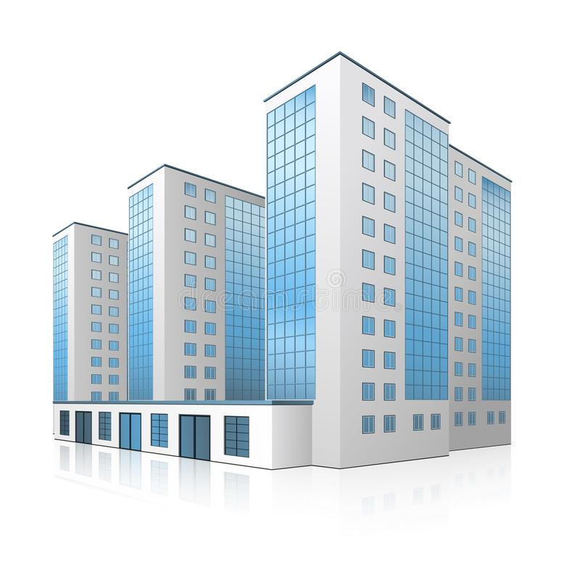
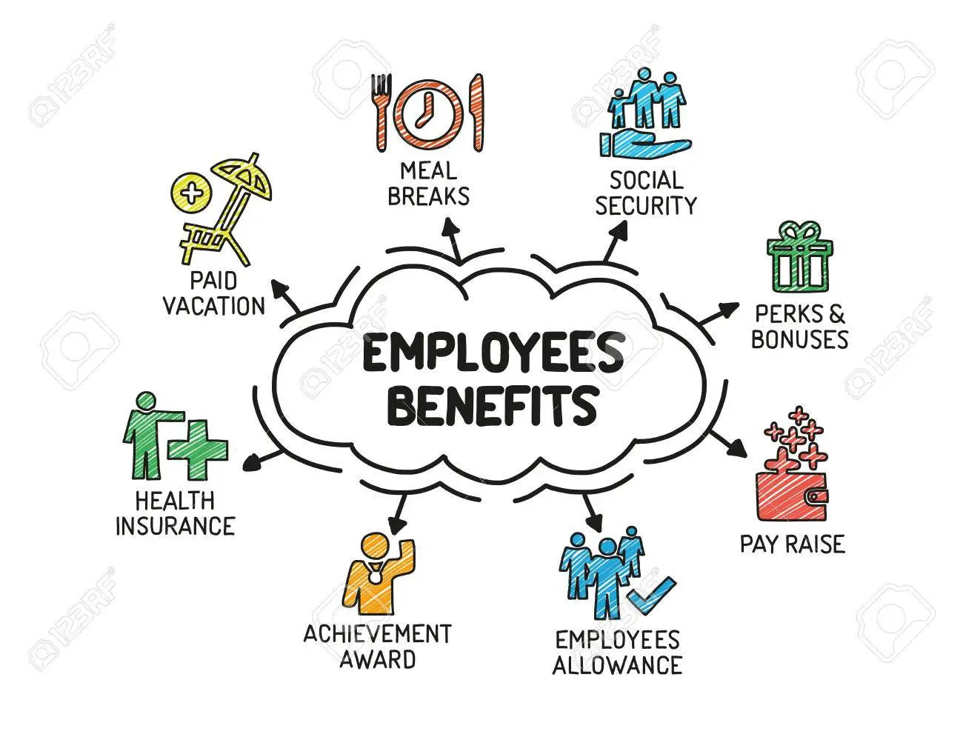
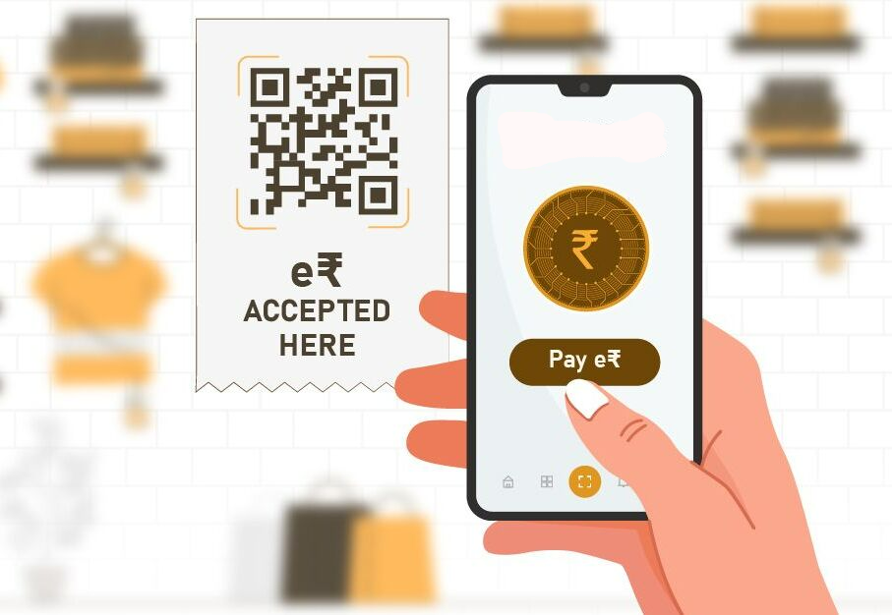
Corporates
Workforce
Pleased Employees
Expenditure Elucidation
Vindicate Solution

Slide 4
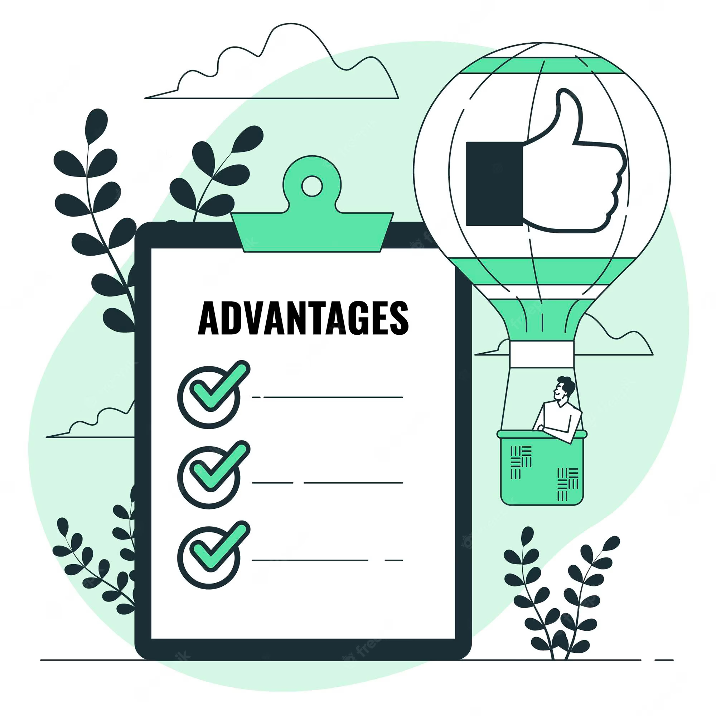
Societal Impact
Corporates loses a lot of money by employees fudging fake receipts and availing extra benefits from company, but through e-Rupi digital wallet this can be prevented.
Digital wallets can help automate expense management, making it easier and faster for employees to make purchases and submit receipts. This can save time for both employees and finance teams.
Digital wallets can help reduce costs associated with paper-based processes, such as printing and storing receipts.
It indirectly supports developing countries to participate in global financial system and parsing a transparency between corporate legislature alongside development of economy.

Slide 5

Methodology
Here are some of the key technologies that can be used in developing e-Rupi digital wallet:
Flutter : For building cross-platform applications to extend user reach to any kind of OS.
Dart : Programming language to be used for Flutter App.
e-Rupi API : APIs to integrate e-Rupi payments in the app, with features like payment initiation, payment confirmation, transaction history, and account management supported.
Http/Rest API Libraries : Flutter packages like ‘http’ or ‘dio’ for handling API calls.
State Management : Provider package for efficient state management.
Firebase Cloud Services : For real-time database/cloud storage, authentication, hosting, notifications etc.
Payment Gateway Integration : Flutter plugins for payment gateways like Stripe, PayPal, and Razorpay etc.
Storage(Local/Repository) : Flutter packages of SQLite and shared-preferences
Architecture/Design Pattern : MVC/MVVM/Repository.
IDEs and Development Tools : VS Code/Android Studio.

Slide 6

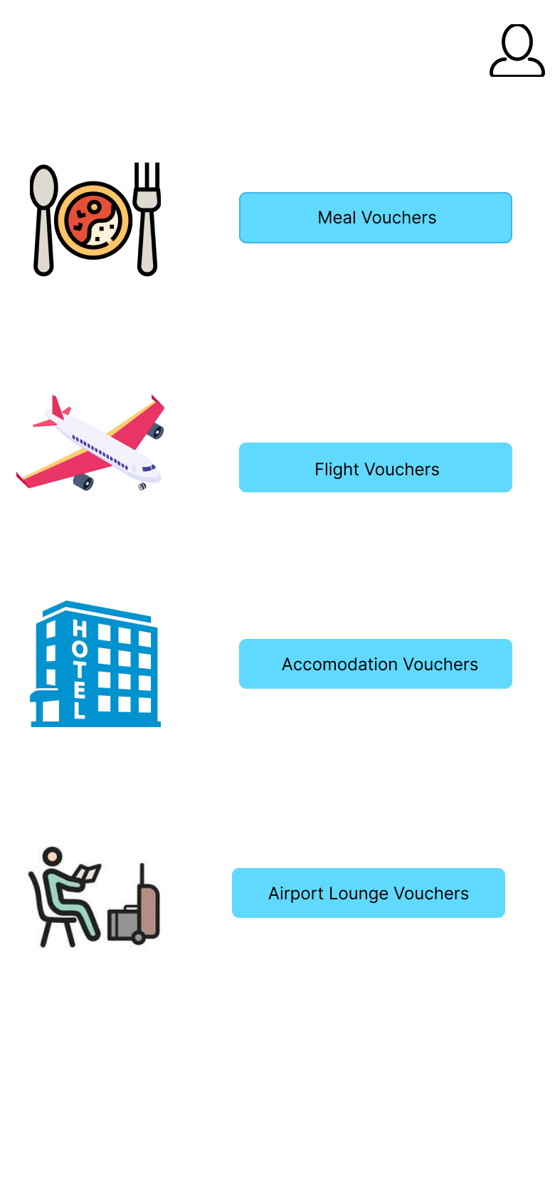
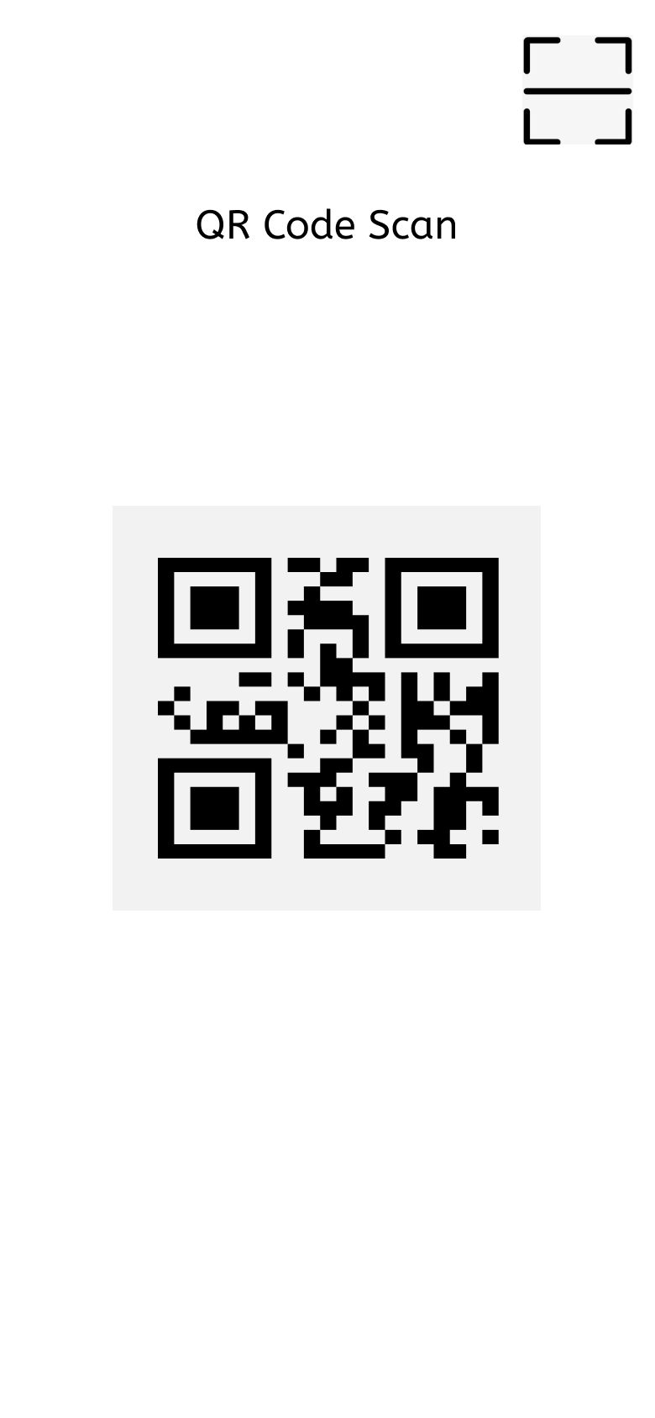
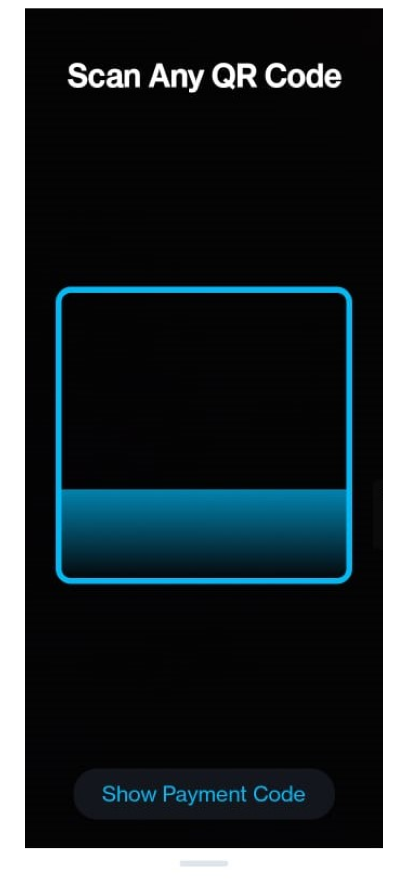
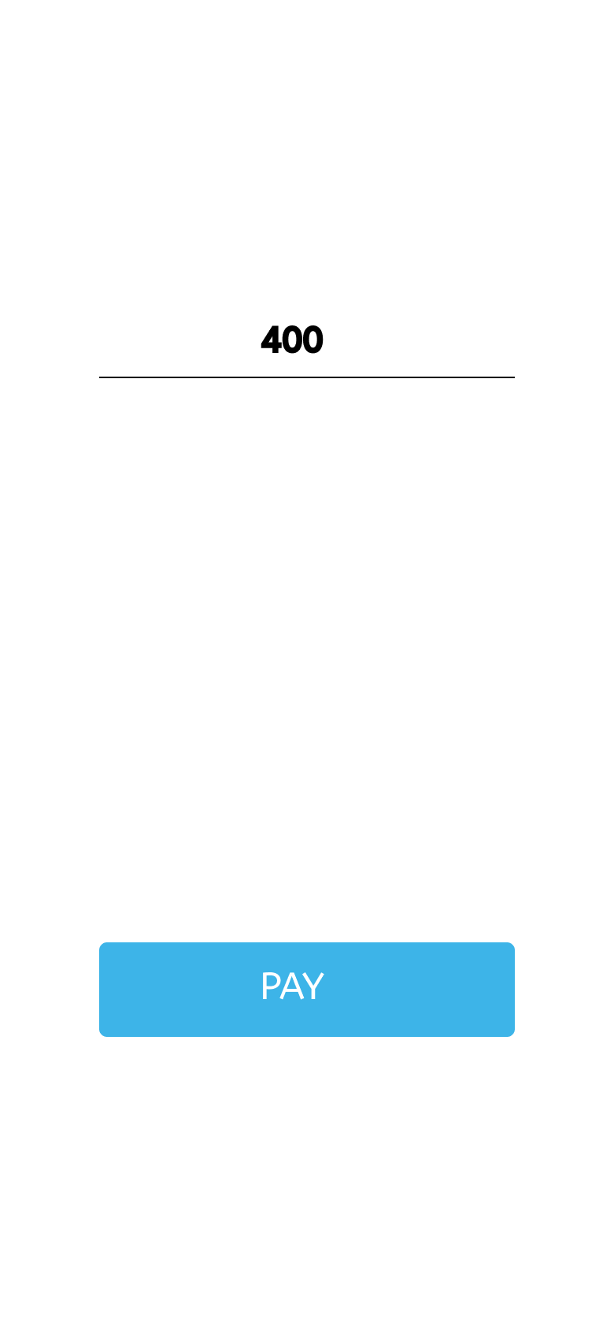

Initial Prototype
Figma Link : Prototype

Slide 7


Business Model and Target User
Product can generate revenue via :
Commission based revenue : Commission that we will charge merchants on each transaction made using digital wallet.
Monetizing App Traffic : Monetizing app traffic by providing targeted offers to users, generating additional revenue.
Other services and products : We can generate revenue by offering our other services and products to the consumer.
Target User :
Corporate companies and government offices which sponsor meals or healthcare facilities as a part of their employee benefit package.
People who have to travel a lot due to their job or business travel.
Urban tier 1 & tier 2 cities- youngsters and middle aged people.

Slide 8

Pondering Points
Regulatory Compliance : Digital wallet system using e-Rupi may be subject to different regulations in different regions, which can create challenges for providers.
User Awareness : Many people are still not aware of digital wallet systems and how they work. This lack of understanding can lead to a hesitancy to adopt them.
Limited Acceptance : Some digital wallet systems are only accepted in certain regions or countries. This can be a significant roadblock for people who frequently travel or conduct business across borders.
Merchant Adoption : For digital wallets to be widely adopted, they must be accepted by a significant number of merchants. If merchants do not support a particular digital wallet system, customers may be hesitant to adopt.
Technology Limitations : Digital wallet systems require reliable internet connectivity and the latest technology to function effectively. This can be a challenge for people living in remote areas or in countries with poor internet infrastructure.

Slide 9
Thank You !

